Slide 1


RETAIL ANALYSIS
PRESENTED BY:
Lokesh Kumar

Slide 2


AGENDA
1 | Architecture
2 | Data Overview
3 | Solution Approach
4 | Analysis
5 | Visualisation
6 | Summary

Slide 3




ARCHITECTURE
SOURCE
ETL
ANALYSIS
VISUALISATION

Slide 4


INJEST
STORE
ANALYSIS
INJEST
STORE
POWERBI

Slide 5


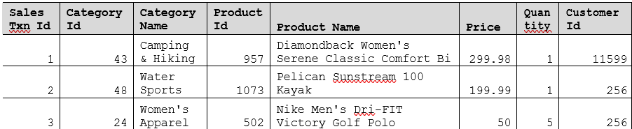
DATA OVERVIEW
ONLINE RETAIL DATA
54000 Rows
8 columns
200 Rows
6 columns
RETAIL DATA
1200 rows
5 columns
CUSTOMER DATA
170000 rows
7 rows
SALES DATA

Slide 6


SOLUTION APPROACH
Imported Data from SQL database.
Created ADF pipeline to get data from SQL Database to ADLS.
Mount the storage to Databricks for easy access.
Analyze and transform the datasets in Databricks.
Use ADF to move the analyzed data from Databricks to SQL Database.
Connect Power BI to the SQL Database.
Create visual reports in PowerPoint using Power BI.
GOAL 1
Customers and SalesTransactions Analysis
GOAL 2
Analyse Retail Data
GOAL 3
Create visual reports

Slide 7
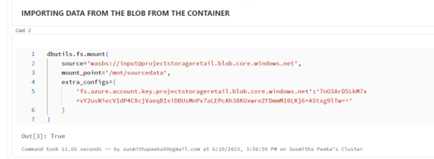
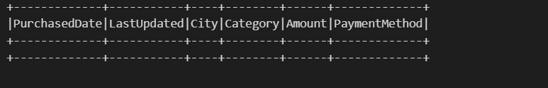
INITIAL CONNECTION
We connect the data in our Blob storage after creating a new databricks workspace
Now we will read the data and do preprocessing and then check null values

Slide 8
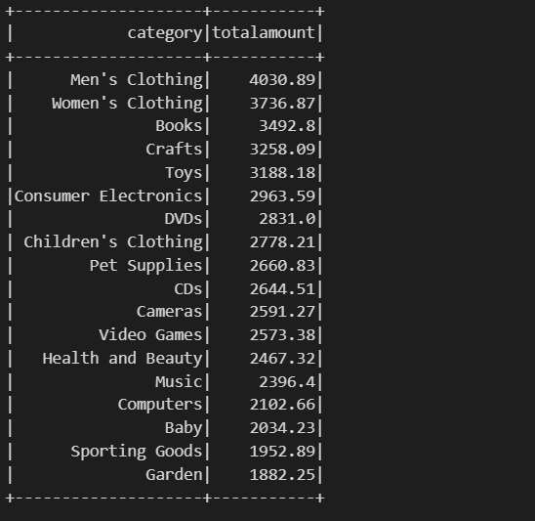
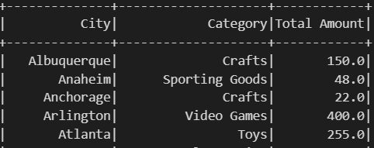
RETAIL_DATASET ANALYSIS
QUERY 1: CATEGORIES THAT SELL THE MOST
QUERY 2: WHICH CATEGORY IS POPULAR IN EACH CITY
window_spec=Window.partitionBy('City').orderBy('Total Amount')
groupbyCategory=df.groupBy('category')
totalamount=totalamount.withColumn("rank", rank().over(window_spec))
query1=groupbyCategory.agg(sum('amount').alias('totalamount'))
query2=query2.select('City','Category','Total Amount')
query1.show()
query2.show()

Slide 9
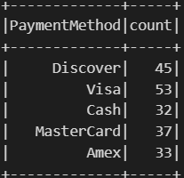
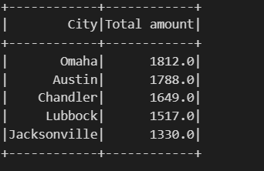
RETAIL_DATASET ANALYSIS
QUERY 3: COUNT OF TRANSACTIONS PER PAYMENT METHOD
QUERY 4: TOP 5 CITIES THAT GENERATED THE HIGHEST REVENUE
query4=groupByCity.agg(sum(col('Amount')).alias("Total amount"))
paymentgroup=df.groupBy('PaymentMethod')
query4=query4.withColumn("Total amount",round('Total amount'))
query3=paymentgroup.agg(count(col('Amount')).alias("count"))
query4=query4.limit(5)
query3.show()
query4.show()

Slide 10
MODULE 2 PYSPARK

Slide 11
PROBLEM STATEMENT
From two sets of data customers,salestxns, we need to get a list of products purchased by the customers. Each record in the list should contain:
Customer Id
Customer Name
Product Id
Product Name
Price
Total Quantity
Total Amount

Slide 12
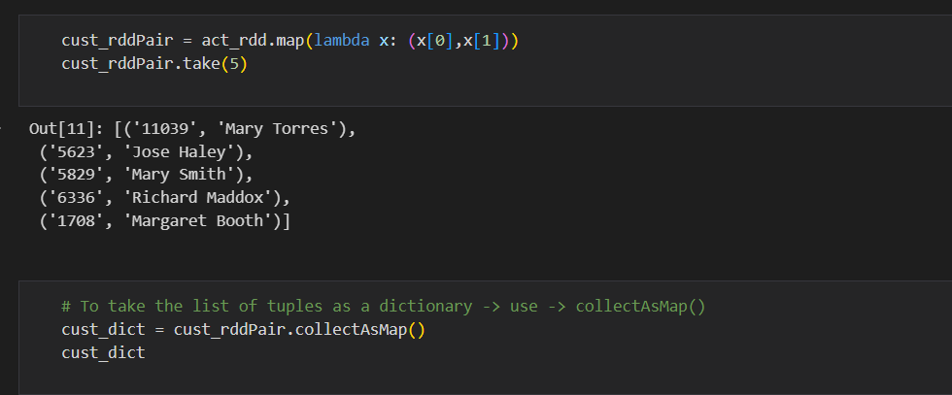
STEP 1
• Read the input file customers.tsv to create the customer RDD and transfiorm RDD to key value pair with customer_id,customer name and saved it as dictionary

Slide 13
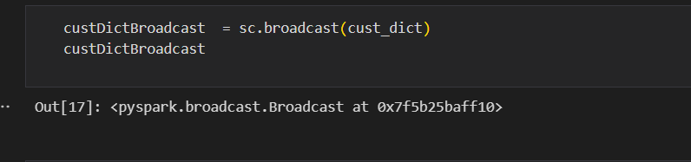
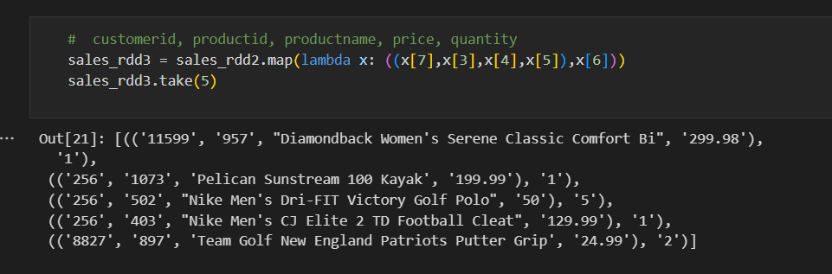
STEP 2
• We will define a broadcast variable - custDictBroadcast and make our dictionary as the broadcast variable in our application
STEP 3
• We now need to transform the RDD into a pairRDD having a key,value pair as the RDD elements with transaction details like (customer id, product id, product name, price) as the key and quantity purchased in the transaction as the value

Slide 14
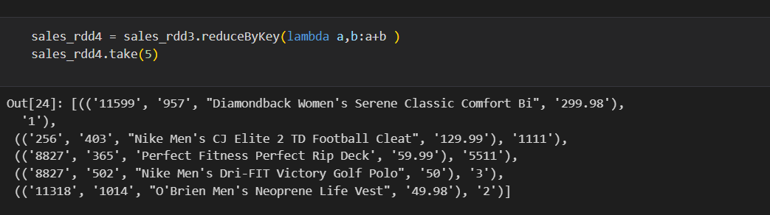
STEP 4
We will use reduceByKey to sum up the quantities of same product bought by same customer. Then we used map the key and value of the above RDD elements such that we will have customer id, product id, product name, price, total quantity purchasedand lastly total amount paid (price * total qty).

Slide 15
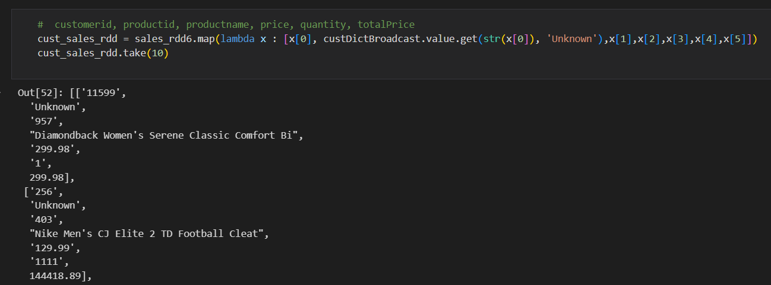
STEP 5
We used the broadcast variable to get the customer name for the corresponding customer id as per the requirement mentioned in the problem statement.
We can save the final RDD using saveASTextFile function. It will create a directory with the given name and saves each partition of the RDD as a text file.

Slide 16
STEP 6
Mounting output to ADLS
# Output mount point
dbutils.fs.mount(
source = 'wasbs://outputs@adlsmain123.blob.core.windows.net',
mount_point = '/mnt/custsales_output_mount', # /mnt/mount point name
extra_configs={
'fs.azure.account.key.adlsmain123.blob.core.windows.net':'1T+QoFNpdK8xY1WmnM2ohQKYIvauNHIiFni2gTzgE4opFAbCD8THRgRFCwiAs3/X9QWz7IVxTXSg+AStKVCLpg=='
}
)

Slide 17
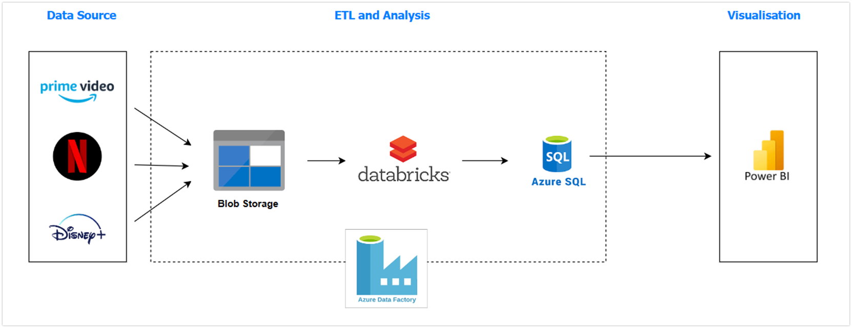
AZURE DATA FACTORY
Now we build pipeline to save the data in ADLS To SQL DATABASES

Slide 18
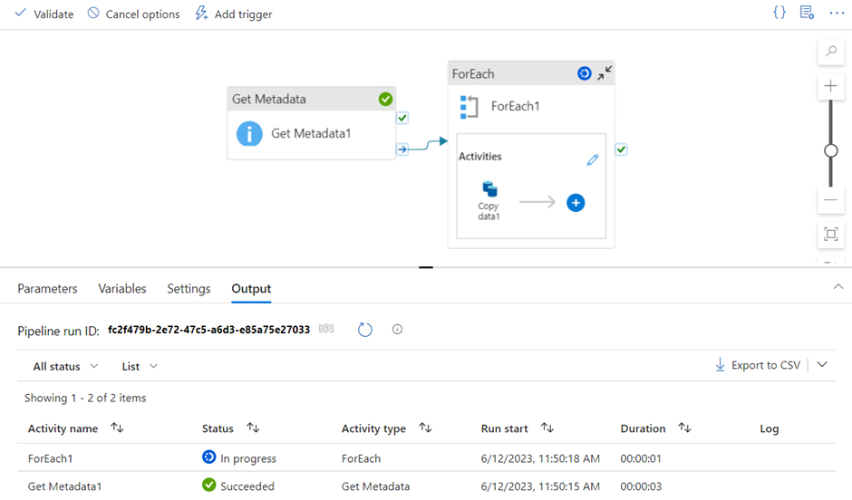
Implementation of pipeline using GetMetaData, ForEach and Copy Data activites to perform the pipeline

Slide 19
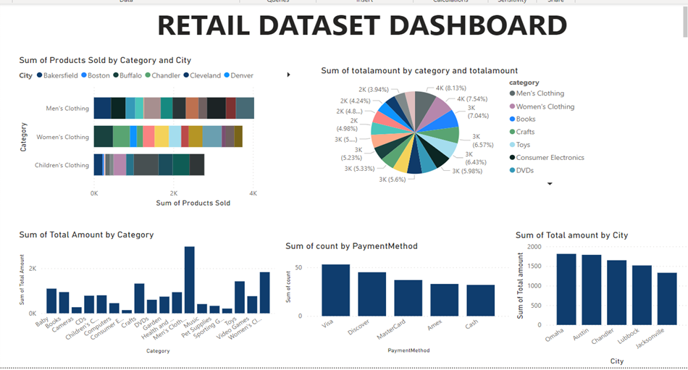

Slide 20
Thank you

